Slide 1

NFPA 72 - 2010
National Fire Alarm & Signaling Code
Rodger Reiswig, SET
Director, Industry Relations
SimplexGrinnell

Slide 2
Take Fire out of NFPA 72?
Why the change?
NFPA 72 now covers many issues in addition to Fire Alarm Systems.
  Combination Systems
  Video Imaging Detection
  Carbon Monoxide Detection
  Supervisory Service of Sprinkler Control Valves
  Water Level Supervisory – 5.15.3
  Water Temperature Supervisory – 5.15.4
  Room Temperature Supervisory – 5.15.5
  Fire Extinguisher Monitoring – 6.8.4.11

Slide 3
NFPA TCC Directive for 2010
Remove the word fire wherever possible
  Chapter 4 – Fundamentals of Fire Alarm Systems
  Chapter 8 – Supervising Station Fire Alarm Systems
  8.3.7.1.1 Alarm signals initiated by manual fire alarm boxes, automatic fire detectors, waterflow from the automatic sprinkler system, or actuation of other fire suppression system(s) or equipment shall be treated as fire alarms.

Slide 4
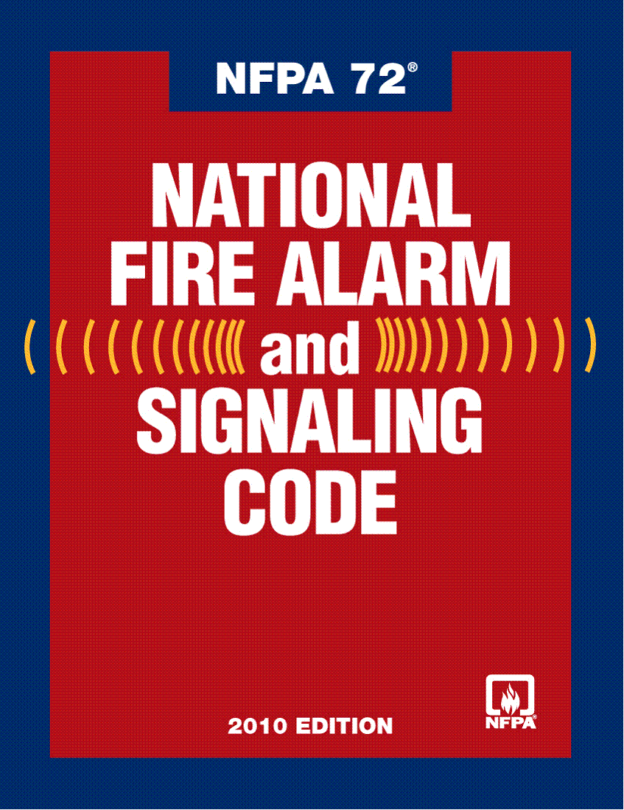
NFPA 72 Name Change?
Previously – National Fire Alarm Code
New Name
  National Fire Alarm and Signaling Code

Slide 5
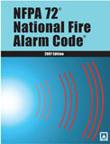
What is changing in 2010 of 72?

Slide 6
NFPA 72, 2010
Chapter Re-Organization
2007 edition had 11 Chapters
2010 edition has 29 Chapters
  Administrative Chapters
  Support Chapters
  System Chapters
  Usability Annexes

Slide 7
Fundamentals
Chapter 10
The Chapter has been renamed Fundamentals. “Fire Alarm” deleted.
The Chapter includes requirements for Emergency Communications Systems.
The word “fire” has been removed throughout in relation to fire alarm systems, as the Code also covers Emergency Communications Systems.

Slide 8
Fundamentals
Chapter 10
10.5.6.3 Capacity
10.5.6.3.1.(A) Battery calculations shall include a 20 percent safety margin to the calculated amp-hour rating
This provides alignment with UL 864 9th edition and the realization that over the life of a battery, it will decay.

Slide 9
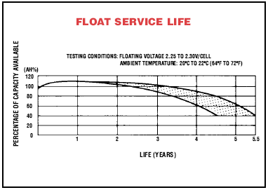

Slide 10
Fundamentals
Chapter 10
10.6 Signal Priority. The priority of signals shall be in accordance with 10.6
10.6.1 ECS priority signals when evaluated by stakeholders through a risk analysis in accordance with 24.4.2.2 shall be permitted to take precedence over all other signals.
This includes fire alarm signals.

Slide 11
Fundamentals
Chapter 10
10.15 Protection of Fire Alarm Systems.
Exception (2) has been removed. This exempted the requirement for smoke or heat detector protecting the FACU, NAC’s or DACT’s if the building is fully sprinklered per NFPA 13.

Slide 12
Fundamentals
Chapter 10
10.18.2.1.2.7 Where not stored at the main fire alarm control unit, the location of these documents shall be identified at the main fire alarm control unit.
Requires the location of the Record of Completion to be identified at the FACU.

Slide 13
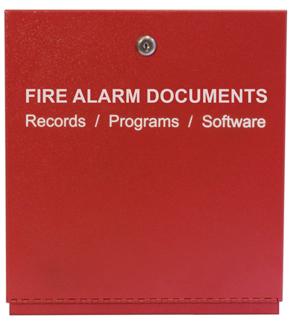
Fundamentals
Chapter 10
10.18.2.1.2.8 If the documents are located in a separate enclosure or cabinet, the separate enclosure or cabinet shall be prominently labeled FIRE ALARM DOCUMENTS.

Slide 14
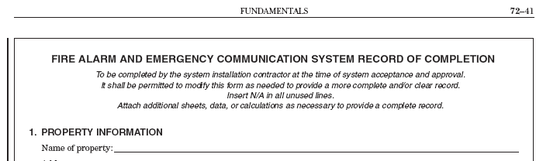
Fundamentals
Chapter 10
Record of Completion.
Has been expanded to 12 pages to enhance its usability.

Slide 15
Circuits and Pathways -
Chapter 12
Wiring tables being replaced with a new system for specifying wiring redundancy and survivability
Includes removal of all of the old class and style tables and designations and the implementation of new Classes that will be applicable to any type of fire alarm circuit, not just SLCs, IDCs, and NACs as in the past.
The term "pathway" is used instead of circuit to account for the use of optical fibers, radio, hardwires, and anything else that may appear in the marketplace.
Notes:
Chapter 10 Inspection, Testing and Maintenance

Slide 16
Circuits and Pathways -
Chapter 12
12.1 Application.
12.1.1 Paths (interconnections) shall be designated based upon the performance characteristics defined in this chapter.
12.2 Purpose.
12.2.1 This chapter describes the performance and survivability characteristics for defined class designations of signaling paths (interconnections).
Notes:
Chapter 10 Inspection, Testing and Maintenance

Slide 17
Circuits and Pathways -
Chapter 12
12.2.2 A path’s (interconnection’s) class designation is dependant on the path’s (interconnection’s) capability to continue to operate during specified fault conditions.
12.2.3 The designation of the paths can also include the performance of the path (interconnection) to survivability from attack by fire.
Notes:
Chapter 10 Inspection, Testing and Maintenance

Slide 18
Circuits and Pathways -
Chapter 12
12.4.2.1 Pathway Class Designations
Pathways shall be designated as Class A, B, C, D, E, or X, depending on their performance as follows:
Class A*. A pathway with a redundant path. Operational capability continues past a single break. Conditions that affect the intended operation of the path are annunciated.
Class B. A pathway without a redundant path. Operational capability stops at a break. Conditions that affect the intended operation of the path are annunciated.
Notes:
Styles going away….going back to Class A
note: This needs to be a NITMAM.

Slide 19
Circuits and Pathways -
Chapter 12
Class C. One or more pathways where operational capability is verified via end-to-end communication, but the integrity of individual paths is not monitored. A loss of end-to-end communication is annunciated.
Class D. A pathway that has fail-safe operation, where no fault is annunciated, but the intended operation is performed instead.

Slide 20
Circuits and Pathways -
Chapter 12
Class E. A pathway which is not monitored for integrity.
Class X. A pathway with a redundant path. Operational capability continues past a single break or short-circuit. Conditions that affect the intended operation of the path are annunciated.

Slide 21
Circuits and Pathways -
Chapter 12
Survivability has also been assigned "levels" in recognition that one size does not fit all. For example:
12.4.1 Pathway Survivability Level 0
Pathway survivability Level 0 shall consist of the following:
a. Pathways shall comply with the requirements of NFPA 70 Articles 760, 770 or 800

Slide 22
Circuits and Pathways -
Chapter 12
12.4.2 Pathway Survivability Level 1
Pathway survivability Level 1 shall consist of the following:
  a. Pathways in buildings fully protected by an automatic sprinkler system in accordance with NFPA 13, Standard for the Installation of Sprinkler Systems and with the interconnecting wiring or cables installed in metal raceways

Slide 23
Circuits and Pathways -
Chapter 12
12.4.3 Pathway Survivability Level 2
Pathway survivability Level 2 shall consist of the following:
  a. 2-hour fire rated circuit integrity (CI) cable or,
  b. 2 hour fire rated cable system (electrical circuit protective system (s) or,
  c. 2-hour fire rated enclosure or protected area or,
  d. 2-hour performance alternatives approved by the authority having jurisdiction
Notes:
Not meant to imply that level 1..is better than level 0, level 2 is better than level 1….etc.

Slide 24
Circuits and Pathways -
Chapter 12
12.4.4 Pathway Survivability Level 3
Pathway survivability Level 3 shall consist of the following:
  a. Pathways in buildings fully protected an automatic sprinkler system in accordance with NFPA 13, Standard for the Installation of Sprinkler Systems and 2-hour fire rated circuit integrity (CI) cable or,
  b. Pathways in buildings fully protected an automatic sprinkler system in accordance with NFPA 13, Standard for the Installation of Sprinkler Systems and 2 hour fire rated cable system (electrical circuit protective system(s)) or,

Slide 25
Circuits and Pathways -
Chapter 12
c. Pathways in buildings fully protected an automatic sprinkler system in accordance with NFPA 13, Standard for the Installation of Sprinkler Systems and 2-hour fire rated enclosure or protected area or,
d. Pathways in buildings fully protected an automatic sprinkler system in accordance with NFPA 13, Standard for the Installation of Sprinkler Systems and 2-hour performance alternatives approved by the authority having jurisdiction

Slide 26
Circuits and Pathways -
Chapter 12
Pathway Class Designations
  A, B, C, D, E, X
Survivability Levels
  0, 1, 2, 3

Slide 27
Inspection, Testing, and Maintenance Chapter 14
Includes Emergency Communications Systems.
Revised requirements for the testing of intelligible voice communications.
New allowance for automated testing.
New requirements for the testing of gas detectors.

Slide 28
Inspection, Testing, and Maintenance Chapter 14
14.2.4 System Documentation.
14.2.4.1 The provided documentation shall include the current revisions of all fire alarm software and the revisions of software of any systems with which the fire alarm software interfaces.

Slide 29
Inspection, Testing, and Maintenance Chapter 14
14.2.4.2 The revisions of the fire alarm software, and the revisions of the software in the systems with which the fire alarm software interfaces, shall be verified for compatibility in accordance with the requirements of 23.2.2.1.1.

Slide 30
Inspection, Testing, and Maintenance Chapter 14
14.2.7 Automated Testing.
14.2.7.1 Automated testing arrangements that provide equivalent means of testing devices to those specified in Table 14.4.2.2 at a frequency at least equivalent to those specified in Table 14.4.5 shall be permitted to be used to comply with the requirements of this chapter.
14.2.7.2 Failure of a device on an automated test shall result in an audible and visual trouble signal.

Slide 31
Inspection, Testing, and Maintenance Chapter 14
14.4.12 In-Building Emergency Radio Communication Systems.
This section was expanded from 2007 to cover:
  Signal level testing.
  System commissioning testing.
  Test procedures
  Measurement parameters
  Acceptance Test
  Annual Tests

Slide 32
Inspection, Testing, and Maintenance Chapter 14
Record of Inspection and Testing
Has been expended to 12 pages
Includes mass notification system interface

Slide 33
Initiating Devices
Chapter 17
17.4.6 Initiating devices shall be installed in all areas, compartments, or locations where required by other NFPA codes and standards or as required by other governing laws, codes, or standards.
This replaces AHJ, and has been added through the body of NFPA 72®.

Slide 34
Initiating Devices
Heat-Sensing Fire Detectors
17.6.2.2.2 Operating Temperature.
17.6.2.2.2.2 Heat-sensing fire detectors where the alarm threshold is field adjustable shall be marked with the temperature range.
17.6.2.2.2.3 Spot-type heat detectors shall also be marked with their RTI.

Slide 35
Initiating Devices
Smoke-Sensing Fire Detectors
17.7.3.2 Spot-Type Smoke Detectors
17.7.3.2.1 Spot-type smoke detectors shall be located on the ceiling or, if on a sidewall, between the ceiling and 12 in. (300 mm) down from the ceiling to the top of the detector.
The 4 inch restriction has been removed.

Slide 36
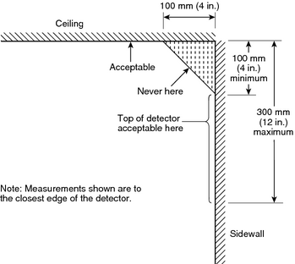
Spacing of Smoke Sensors
72, 2007
72, 2010

Slide 37
Notification Appliances
Chapter 18
18.4.5 Sleeping Area Requirements.
18.4.5.3 Effective January 1, 2014, where audible appliances are provided to produce signals for sleeping areas, they shall produce a low frequency alarm signal that complies with the following:
  (1) The alarm signal shall be a square wave or provide equivalent awakening ability.
  (2) The wave shall have a fundamental frequency of 520 Hz ± 10 percent.

Slide 38
Notification Appliances
Chapter 18
18.4.10 Voice Intelligibility. Within the acoustically distinguishable spaces (ADS) where voice intelligibility is required, voice communications systems shall reproduce prerecorded, synthesized, or live (e.g., microphone, telephone handset, and radio) messages with voice intelligibility.

Slide 39
Notification Appliances
Chapter 18
18.4.10.1 Acoustically distinguishable spaces (ADS) shall be determined by the system designer during the planning and design of all emergency communications systems.
18.4.10.2 Each ADS shall be identified as requiring or not requiring voice intelligibility.
18.4.10.3 Where required by the authority having jurisdiction, ADS assignments shall be submitted for review and approval.

Slide 40
Notification Appliances
Chapter 18
3.3.2* Acoustically Distinguishable Space (ADS). An emergency communications system notification zone, or subdivision thereof, that might be an enclosed or otherwise physically defined space, or that might be distinguished from other spaces because of different acoustical, environmental, or use characteristics, such as reverberation time and ambient sound pressure level. (SIG-NAS)

Slide 41
Emergency Control Functions and Interfaces – Chapter 21
Used to be Fire Safety Functions in Chapter 6
Name changed to include non-fire alarm emergency functions
Includes requirements for elevator recall

Slide 42
Protected Premises
Chapter 23
All voice communications material has been moved from chapter 6 and placed in chapter 24
Fire Safety Functions have also moved from chapter 6 and are now in chapter 21
  Generalizes material in chapter 21 and allows for both fire alarm and mass notification correlation

Slide 43
Protected Premises
Chapter 23
Requirements for combination systems revised
  Sharing wiring for robust systems will be easier
Language added to Annex confirming that the Chapter is applicable to fire alarm systems used for mass notification.
Language revised to not limit application to fire emergencies only.

Slide 44
Supervising Station Fire Alarm Systems – Chapter 26
26.6.3.2.1.4 Transmission Channels.
(A)* A system employing a DACT shall employ one telephone line (number). In addition, one of the following transmission means shall be employed:

Slide 45
Supervising Station Fire Alarm Systems – Chapter 26
  (1) A second telephone line (number)
  (2) A cellular telephone connection
  (3) A one-way radio system
  (4) A one-way private radio alarm system
  (5) A private microwave radio system
  (6) A two-way RF multiplex system
  (7) A transmission means complying with 26.6.3.1

Slide 46
Supervising Station Fire Alarm Systems – Chapter 26
26.6.3.1.4 Communications Integrity
Provision shall be made to monitor the integrity of the transmission technology and its communications path. The following requirements shall apply:
(1) Any failure shall be annunciated at the supervising station within 5 minutes of the failure. (2) If communications cannot be established with the supervising station, an indication of this failure to communicate shall be annunciated at the protected premises.

Slide 47
Supervising Station Fire Alarm Systems – Chapter 26
(3) If a portion of the communications path cannot be monitored for integrity, a redundant communications path shall be provided.
(4) Provision shall be made to monitor the integrity of the redundant communications path.
(5) Failure of both the primary and redundant communications paths shall be annunciated at the supervising station within not more than 24 hours of the failure.

Slide 48
Single- and Multiple-Station Alarms and Household Fire Alarm Systems – Chapter 29
29.3.7.1* Where notification for the hearing impaired is required by governing laws, codes or standards, or where otherwise provided in sleeping rooms occupied by people with mild to severe hearing loss, a low frequency alarm signal shall be provided. The low frequency alarm signal output shall comply with the following:

Slide 49
Single- and Multiple-Station Alarms and Household Fire Alarm Systems – Chapter 29
  (1) The alarm signal shall be a square wave or provide equivalent awakening ability.
  (2)* The wave shall have a fundamental frequency of 520 Hz + / - 10% .
  (3) The minimum sound level at the pillow shall be 75 dBA, or 15 dB above the ambient noise level, whichever is greater.

Slide 50
Mass Notification and NFPA

Slide 51
Chapter reference for MNS in
NFPA 72, 2007
Chapters 4 thru 11 currently ends with:
  Mass Notification Systems. See Annex E.

Slide 52
NFPA and Mass Notification
NFPA 72, 2007 Annex E, Mass Notification Systems replaced by Chapter 24 Emergency
Communications Systems
Content from 2007 edition Chapter 6, Protected Premises Fire Alarm Systems
  Emergency Voice Alarm Communications
  Two-Way Communication Service

Slide 53
NFPA and Mass Notification
Chapter 24 Emergency Communications Systems
24.1 Introduction
  Emergency Communications Systems (ECS) shall consist of two classifications of systems, one-way and two-way.

Slide 54
NFPA and Mass Notification
Chapter 24 Emergency Communications Systems
24.2 One-Way Emergency Communications Systems
24.2.1 In-Building Emergency Voice/Alarm Communications Systems
24.2.1.1* Section 24.2.1 shall be used in the design and application of emergency voice/alarm communications for fire alarm systems.

Slide 55
NFPA and Mass Notification
Chapter 24 Emergency Communications Systems
24.2.1.8 Priority.
24.2.1.8.1 When the fire alarm system has been activated, and mass notification has been given priority, an audible and visible indication shall be provided at the building fire alarm control unit.
24.2.1.8.2 The fire alarm system shall not automatically override emergency mass notification messages.

Slide 56
NFPA and Mass Notification
Chapter 24 Emergency Communications Systems
24.2.1.11* Relocation and Partial Evacuation. The requirements of 24.2.1.11 shall apply only to systems used for relocation or partial evacuation.

Slide 57
NFPA and Mass Notification
Chapter 24 is a complete set of requirements for emergency communications systems – including requirements from other chapters by reference.
Will include EVAC and Two-way communications relocated from Chapter 6.
  Fire Fighter phones
  Fire Alarm Voice Evacuation

Slide 58
One-Way ECS Wide Area MNS
High powered speaker arrays (HPSA) for large outdoor areas
Mounted at heights to prevent hearing damage to nearby persons
Are not permitted to provide mass notification to occupants inside structures or buildings

Slide 59
One-Way ECS Distributed Recipient MNS
Communication to a wide range of targeted individuals or groups
Systems include mass dialing systems, reverse 911, email, SMS (mobile phone text messages), and other directed communication methods

Slide 60
Two-Way ECS Radio Emergency Services
In Building amplifiers
  Bidirectional amplifiers

Slide 61

Questions?
Rodger Reiswig, SET

